Slide 1

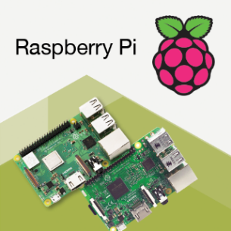

Week 2
WEEKLY STATUS REPORT
IoT Blockchain and its applications in Logistics
ETHEREUM
RASPBERRY PI
Mentor: Nguyen Xuan Thong
Reporter: Thanh Tung – Thanh Phuong

Slide 2
1
Describe the model of Project
2
Introducing about Ethereum
CONTENTS
Ethereum and Raspberry Pi integration
3
Raspnode and Ethereum Blockchain in Project usecase
4

Slide 3

DESCRIBE THE MODEL OF PROJECT
PART 01

Slide 4


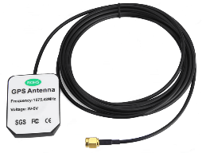
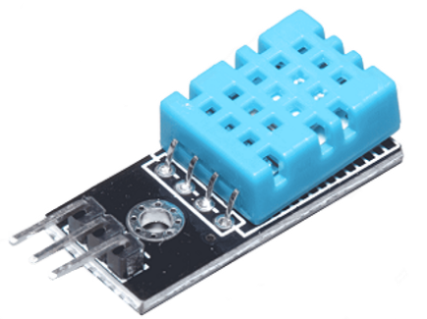

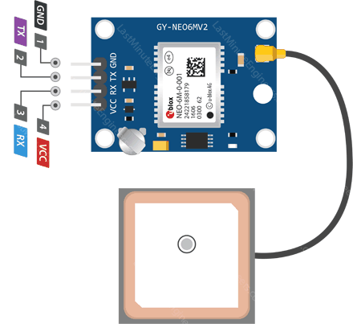





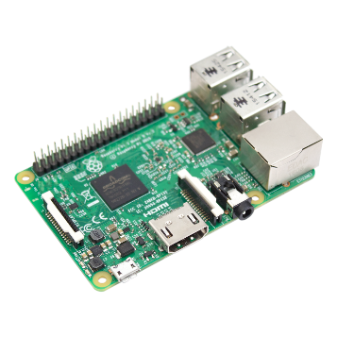







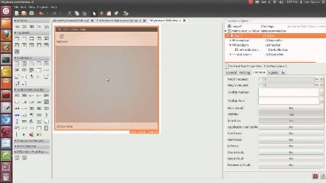



THE MODEL OF PROJECT
Anten GPS 1575.42 MHz
Input from GUI
Module GPS U-Blox NEO 6-M
DHT11 Sensor
transport
import
Certificate of Origin
Certificate of Quality
Batch Numbers
Barcodes
Processing Data
Auto Detect
RaspNode #1
Shipment Dates
Location
Status: Temperature – Humidity
GUI
Barcode Scanner
RaspNode #n

Slide 5





THE MODEL OF PROJECT
PC – WEBSITE
Name
Origin
Real–time status | Temperature
 | Humidity
Other information
Real–time location:
COSTUMER
MOBILE APP

Slide 6

INTRODUCING ABOUT ETHEREUM
PART 02

Slide 7





INTRODUCING ABOUT ETHEREUM
A wonderful platform for creating Blockchain
Ethereum is an open source, public, blockchain-based distributed computing platform and operating system featuring smart contract (scripting) functionality
Ethereum Virtual Machine (EVM)
Ethereum provides a decentralized virtual machine, the Ethereum Virtual Machine (EVM), which can execute scripts using an international network of public nodes.
Smart Contract
DAPP
Ethereum - a popular platform for creating distributed Blockchain applications that support smart contracts
Distributed Application (DAPP)
DApp is an abbreviated form for decentralized application.
DApp = frontend + contracts

Slide 8
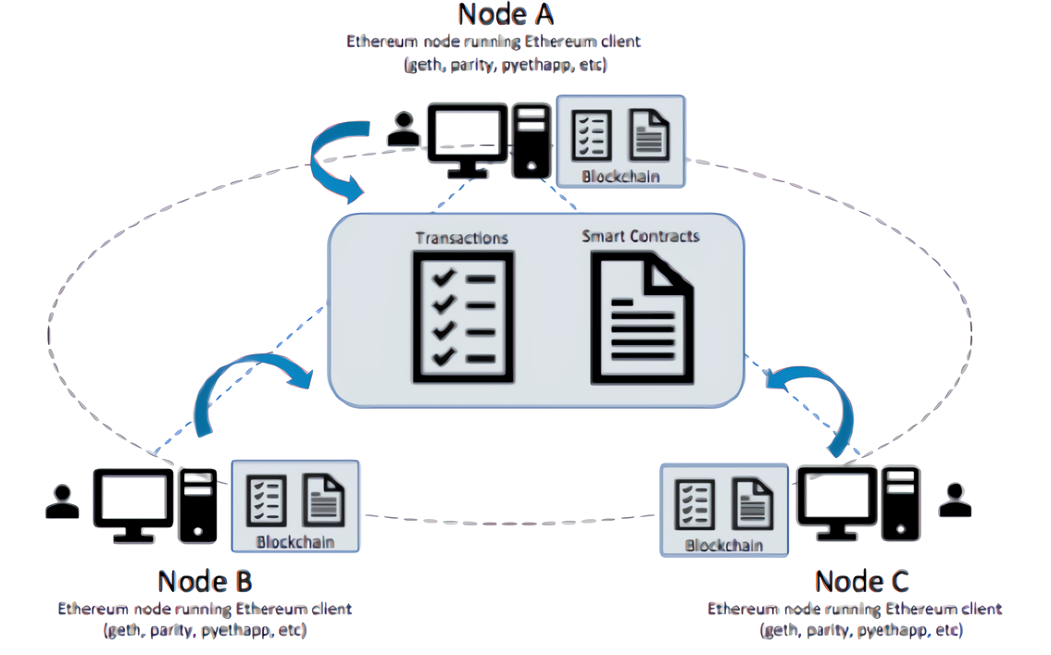
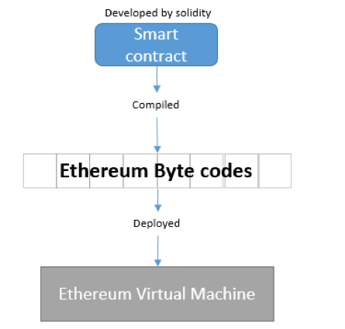
INTRODUCING ABOUT ETHEREUM
How Ethereum works?

Slide 9
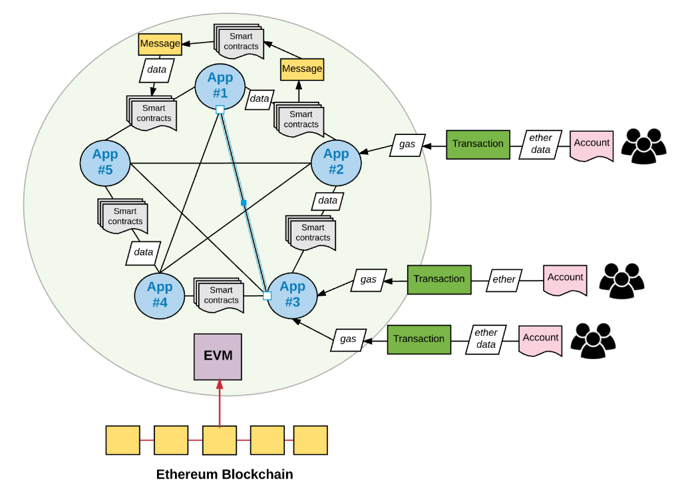
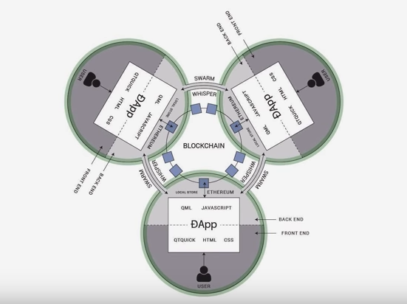
INTRODUCING ABOUT ETHEREUM
Decentralized Application (DApp)

Slide 10
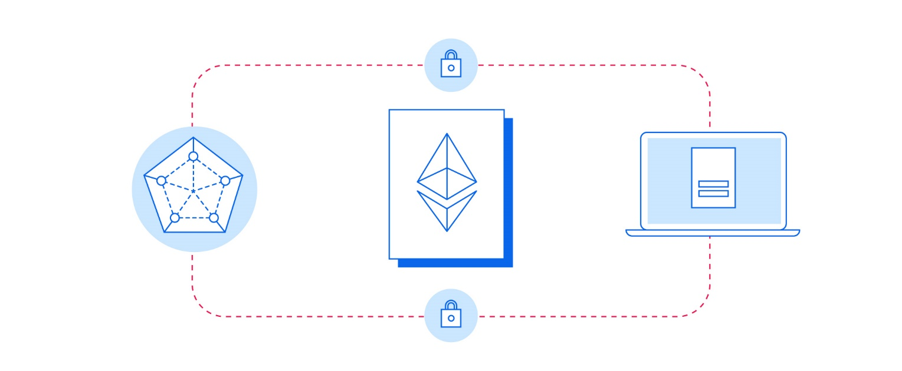
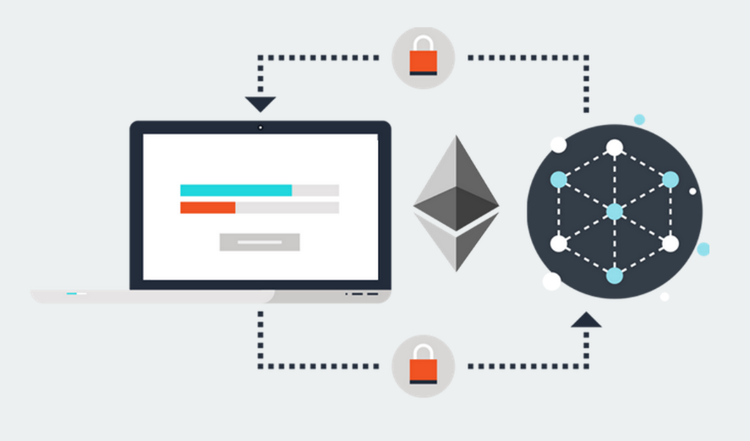
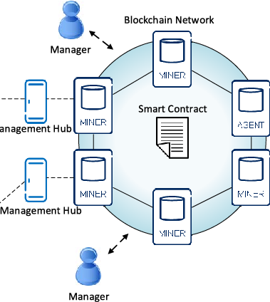
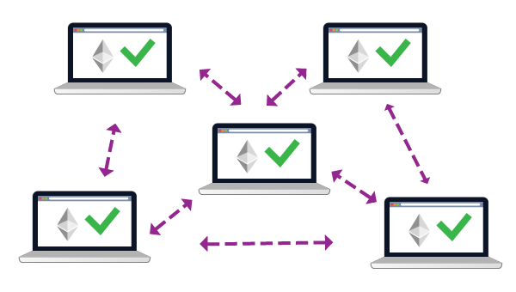

INTRODUCING ABOUT ETHEREUM

Slide 11




INTRODUCING ABOUT ETHEREUM
Geth
Geth = Go + Ethereum Geth is a popular client that provide the command line interface for running a full ethereum node in 'Go'.
Golang
A programming language for running and controlling Ethereum node.
Remix – Ethereum IDE
Solidity
Solidity was influenced by C++, Python and JavaScript and is designed to target the Ethereum Virtual Machine (EVM). https://remix.ethereum.org
Solidity is an object-oriented, high-level language for implementing smart contracts. Smart contracts are programs which govern the behaviour of accounts within the Ethereum state.

Slide 12
Ethereum and Raspberry Pi integration
PART 03
ETHEREUM
RASPBERRY PI

Slide 13

Ethereum and Raspberry Pi integration
GETH
1. Stand for go-Ethereum
2. Geth is the the command line interface for running a full ethereum node implemented in GoLang
Capabilities
By installing and running geth, you can take part in the ethereum frontier live network and :
Mine real ether
Transfer funds between addresses
Create contracts and send transactions
Explore block history
And much much more

Slide 14
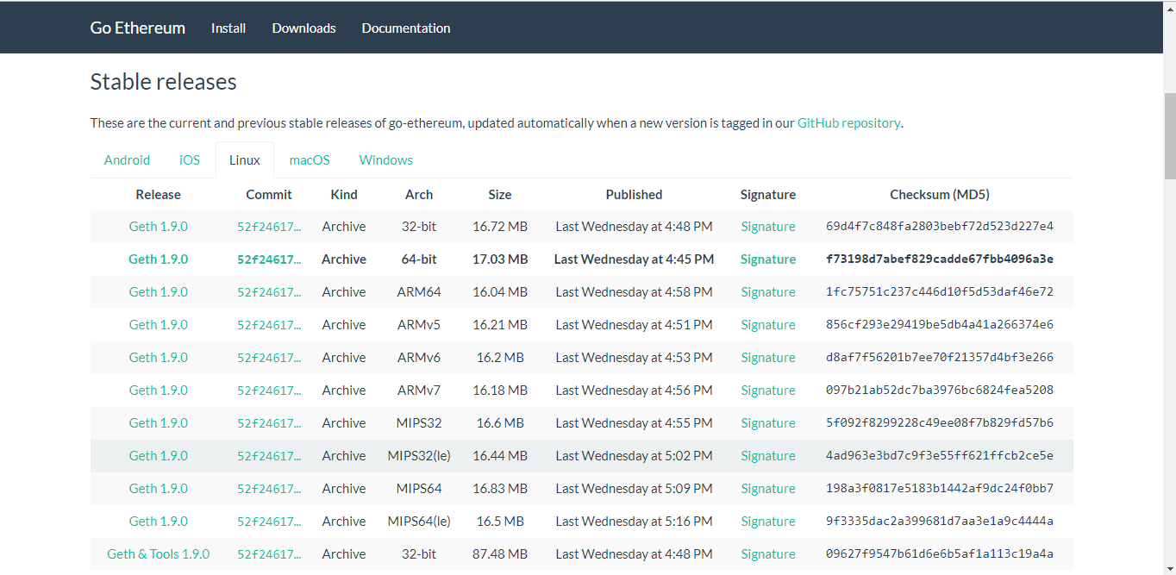
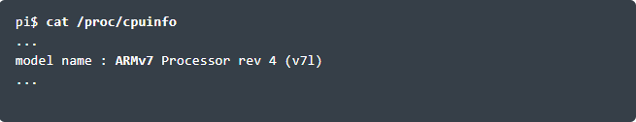
Ethereum and Raspberry Pi integration
I. Install geth
1. Connect to your RPi and retrieve the type of your CPU:
2. Select the tab Linux from the stable releases page.
Locate the row related to your CPU model and copy the link address (https://geth.ethereum.org/downloads/). It’s recommended to retrieve the latest version of Geth.

Slide 15
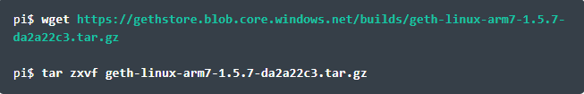

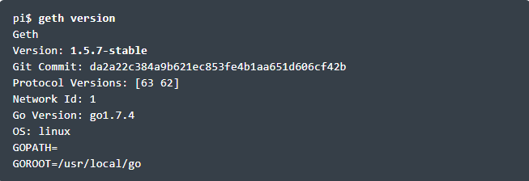
Ethereum and Raspberry Pi integration
II. Extract and run
1. Back to your RPi, retrieve the bundle and extract the archive:
2. Copy the Geth application to the /usr/local/bin folder:
3. Check the version of geth

Slide 16
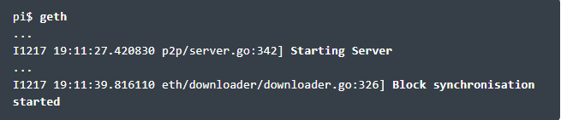
Ethereum and Raspberry Pi integration
Run geth
At this stage, Ethereum is installed on your computer and able to synchronise with the live chain (mainnet).
The blockchain (chaindata) is located right here:
Mac: ~/Library/Ethereum/chaindata
Windows: %APPDATA%\Ethereum
Linux: ~/.ethereum
Your accounts will be stored in a wallet located in this folder:
Mac: ~/Library/Ethereum/chaindata/keystore
Windows: %APPDATA%\Ethereum\keystore
Linux: ~/.ethereum/keystore

Slide 17
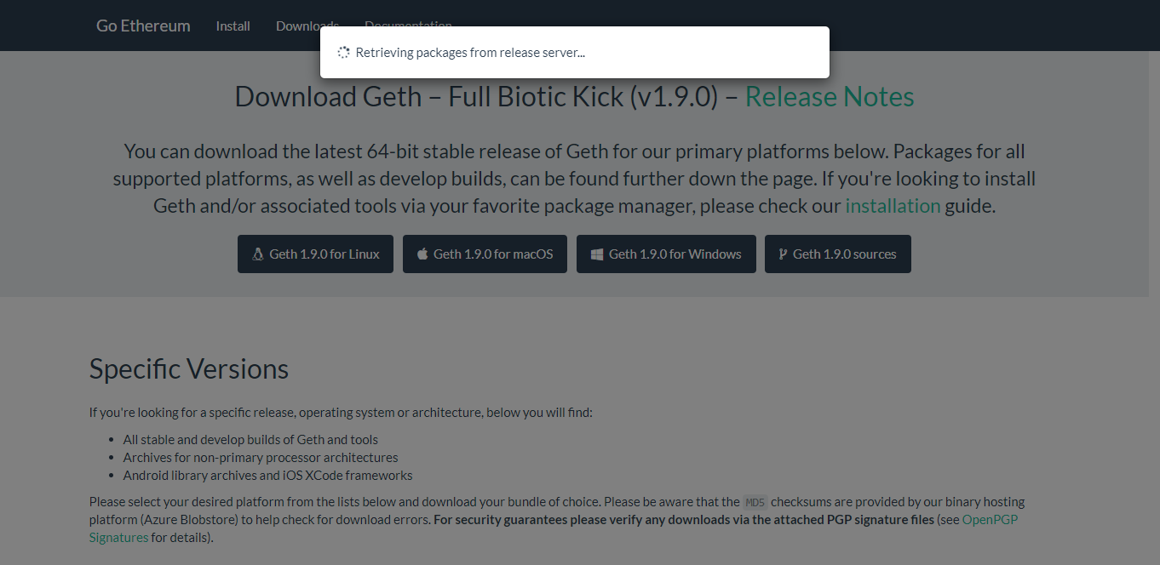
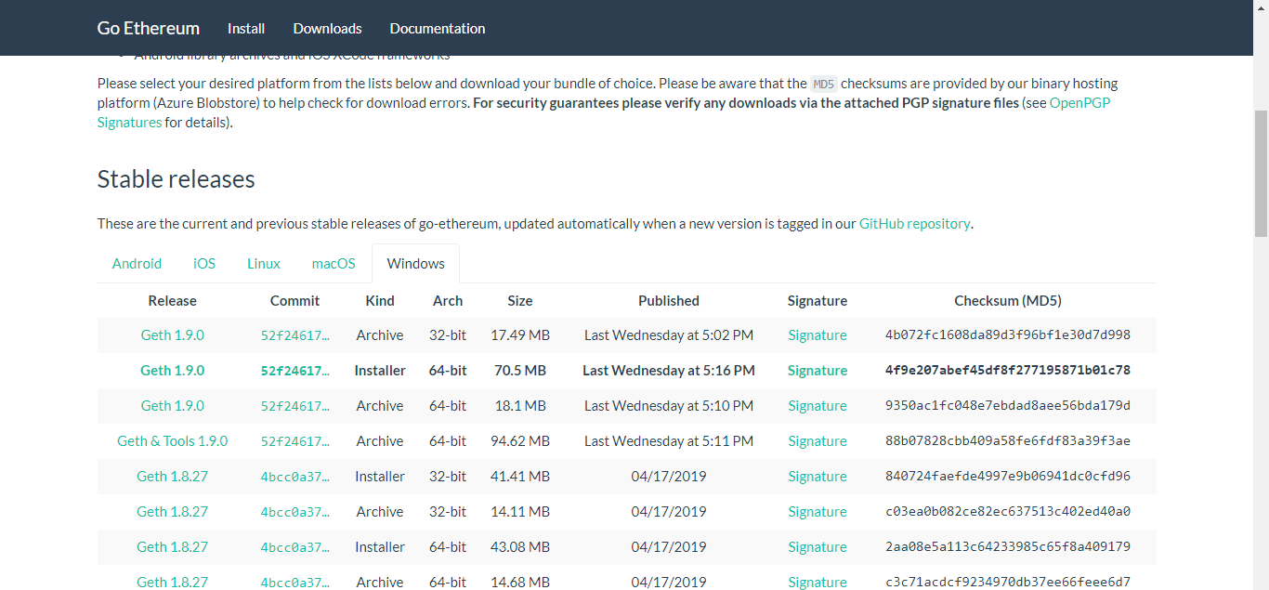
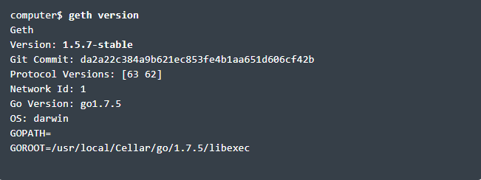
Ethereum and Raspberry Pi integration
III. Install Geth on computer
Follow the step are done with RPI, we can fully install geth our host computer.
(https://geth.ethereum.org/downloads/)

Slide 18
Ethereum and Raspberry Pi integration
III. Setup the private chain - miner
Before we describe the steps to start the miners, it is important to understand the requirements for each node to join the same private blockchain:
Each node will use a distinct data directory to store the database and the wallet.
Each node must initialize a blockchain based on the same genesis file.
Each node must join the same network id different from the one reserved by Ethereum (0 to 3 are already reserved).
The port numbers must be different if different nodes are installed on the same computer.
All the operations must be performed from your computer.

Slide 19
Ethereum and Raspberry Pi integration
Step 1 – Create the datadir folder
When running a private blockchain, it is highly recommended to use a specific folder to store the data (database and wallet) of the private blockchain without impacting the folders used to store the data coming from the public blockchain.
From your computer, create the folder that will host your first miner:
Repeat the operation for the second miner:

Slide 20
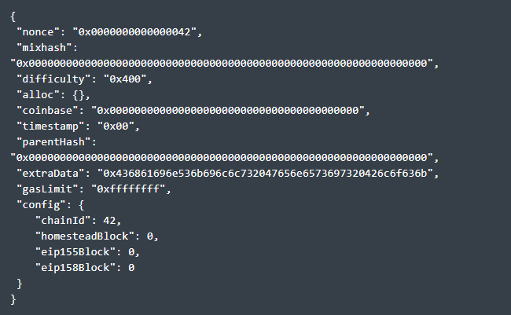
Ethereum and Raspberry Pi integration
Step 2 – Create the Genesis file
Each blockchain starts with a genesis block that is used to initialize the blockchain and defines the terms and conditions to join the network.
Our genesis block is called “genesis.json” and is stored under “~/ChainSkills” folder.
Create a text file under ~/ChainSkills, called genesis.json, with the following content:

Slide 21
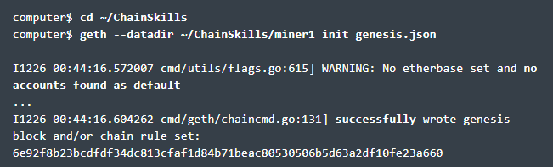
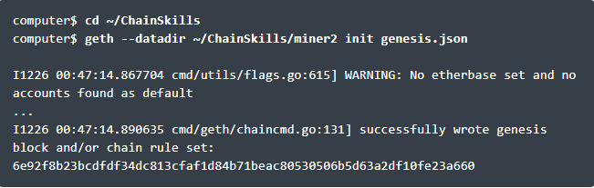
Ethereum and Raspberry Pi integration
Step 3 – Initialize the private blockchain
Step 3.1 – Initialize miner #1
Type the following command to create the blockchain for the first miner:
The logs provide the following information:
you need a default account
the blockchain has been successfully created
If you list the content of the miner1 folder, you will notice the following subfolders:
geth: contains the database of your private blockchain (chaindata).
keystore: location of your wallet used to store the accounts that you will create on this node.

Slide 22
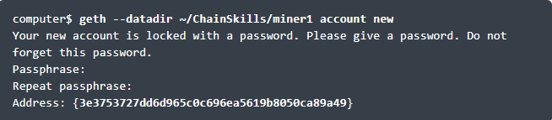
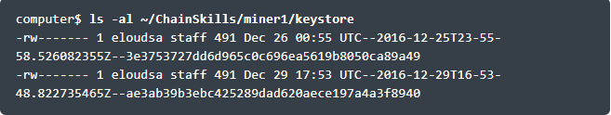
Ethereum and Raspberry Pi integration
Step 4 – Create accounts
Step 4.1 – Accounts for miner #1:
Create the default account that will be used to run the node.
This account will receive all ethers created by the miner in the private blockchain. These ethers will serve to test our solutions by paying the gas required to process each transaction.
To create the default account for the miner #1, type the following command. Keep the password in a safe place:
The wallet for these accounts is located right here:

Slide 23
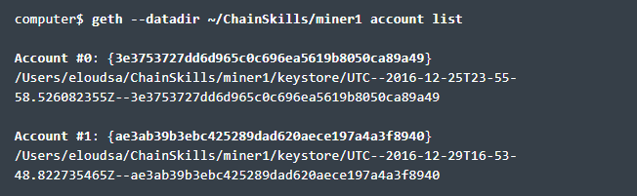
Ethereum and Raspberry Pi integration
To list all accounts of your node, use the following command:
Repeat the same operation to create the default account for the second miner. The difference lies in the target folder (~/ChainSkills/miner2).

Slide 24
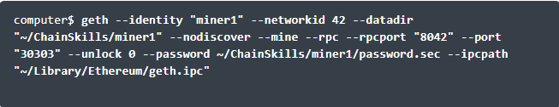
Ethereum and Raspberry Pi integration
Step 5 – Prepare the miners
Step 5.1 – Miner #1: setup
Let’s start by creating a file that will contain the password for our default account, which is the first account we created for each miner. Create a password.sec file under ~/ChainSkills/miner1/ that contains the password you configured for the first account on miner1, in plain text.
To start the miner #1, we will require to run the following command:

Slide 25
Ethereum and Raspberry Pi integration
The meaning of the main parameters is the following:
identity: name of our node
networkid: this network identifier is an arbitrary value that will be used to pair all nodes of the same network. This value must be different from 0 to 3 (already used by the live chains)
datadir: folder where our private blockchain stores its data
rpc and rpcport: enabling HTTP-RPC server and giving its listening port number
port: network listening port number, on which nodes connect to one another to spread new transactions and blocks
nodiscover: disable the discovery mechanism (we will pair our nodes later)
mine: mine ethers and transactions
unlock: id of the default account
password: path to the file containing the password of the default account
ipcpath: path where to store the filename for IPC socket/pipe

Slide 26
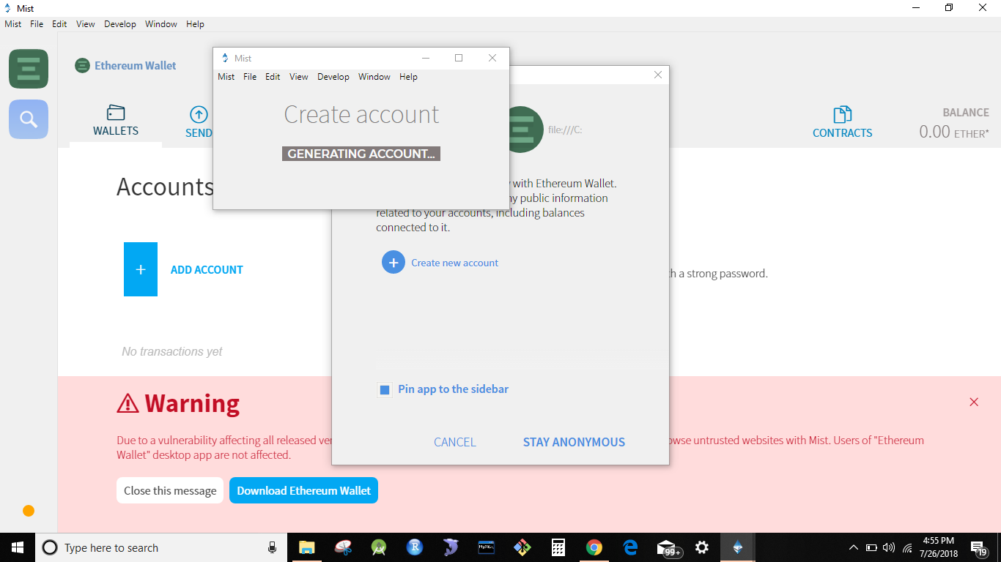
Ethereum and Raspberry Pi integration
What’s the meaning of the parameter “ipcpath“? If you want to manage your private blockchain via the Mist browser, you will need to create the “geth.ipc” file in the default Ethereum folder. Mist will detect that your private network is running and will connect to it rather than starting its own instance of Geth.

Slide 27

Ethereum and Raspberry Pi integration
Step 5.2 – Miner #1: start
You will notice that the server and the mining process start.
You default account will receive ethers mined by the node.
If you start Mist, you will see that the default account is rewarded by ethers. Remember that these ethers are fake money only available in your private blockchain and not on the live main chain. So, you are not (yet) rich 😉

Slide 28
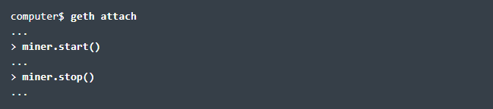
Step 5.3 – Miner #1: JavaScript console
Ethereum and Raspberry Pi integration
You can manage your miner using the Geth Javascript console.
For example, you can start and stop mining from the console or send transactions.
This console needs to be attached to a running instance of Geth.
Open a new terminal session and type “geth attach“.
If you want to start or stop the mining process, proceed as below:

Slide 29

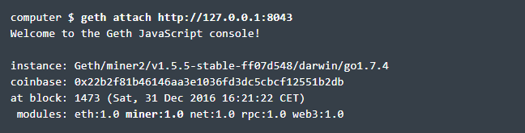
Step 5.6 – Miner #2: JavaScript console
Ethereum and Raspberry Pi integration
As for miner #1, we can manage our node through the JavaScript console.
Unlike miner #1, we will have to attach the console to the running instance of Geth because its “geth.ipc” file has been generated in the “datadir” folder and not in the default Ethereum folder.
To attach the console, you can attach it by mentioning the path to the IPC-RPC interface (geth.ipc):

Slide 30
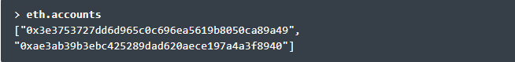
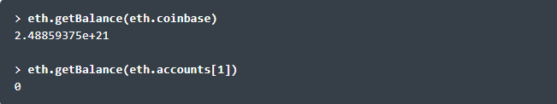
Ethereum and Raspberry Pi integration
Prepare for send ethers
Step 6.2 – Check balances
Get the default account with “eth.coinbase”:
List the accounts with “eth.accounts”:
Check balances with
“eth.getBalance(<account id>)”:
The default account has plenty of ethers obtained during the mining process. We will use them to test our solutions.
Use the following command to get the balance in ether.
By default, the balance is expressed in Wei that is the base unit of ether.
1 ether = 10^18 Wei

Slide 31

Raspnode and Ethereum Blockchain in Project usecase
PART 04

Slide 32




REFERENCE MATERIAL
SOURCE
[1] ChainSkills – Create a private Ethereum blockchain with IoT devices https://chainskills.com
[2] DesignSpark – Exploring Ethereum with Raspberry Pi https://www.rs-online.com/designspark/
ONLINE SOURCE
[3] Tutorialspoint – Simple Easy Learning, https://www.tutorialspoint.com/ethereum/
[4] Tech in Sight – Wonderful framework – Ethereum Blockchain https://techinsight.com.vn/ethereum-nen-tang-tuyet-voi-cho-blockchain/
[5] Remix – Ethereum IDE, https://remix.ethereum.org/
[6] Talk Crypto – Raspberry Pi 3, Node and Ethereum, http://www.talkcrypto.org/blog/2018/03/06/raspberry-pi-3-node-and-ethereum/

Slide 33
THANK YOU
FOR YOUR LISTENING

